Slide 1
Chapter 7： DC-DC Switch-Mode Converters:
7-1 Introduction
7-2 Control of dc-dc Converters
7-3 Step-Down (Buck) Converter
7-4 Step-Up (Boost) Converter
7-5 Buck-Boost Converter
7-6 Cuk dc-dc Converter
7-7 Full Bridge dc-dc Converter
7-8 dc-dc Converter Comparison

Slide 2
7-6 Cuk dc-dc Converter
i_{L1}
v_{C1}
i_{L2}
+
V_{d}
-
L₁
L₂
+ C₁ -
-
V_{o}
+
+ v_{L1} -
T
- v_{L2} +
D
R
C₂
i_{T}
i_{D}
Similar to a buck-Boost converter, the cuk converter provides a negative-polarity output voltage with respect to the common terminal of the input voltage, and the output voltage can be either higher or lower than the input voltage.
unlike the buck-boost converter, both the input current and the output current are not pulsation.
In steady-state: V_{c1}=V_{d}+V_{o}

Slide 3
U
G
0
t
7-6-1 continuous-conduction mode ☆
T
S
U
L1
1 Operation principle
U
d
0
t
(1) When the switch is on:
The input feeds energy to L₁, i_{L1}↑.
V_{c1} reverse biases the diode. i_{L1} and i_{L2} flow through the switch. C₁ discharge through the switch, transferring energy to the output and L₂ . i_{L2} ↑.
T
−
(
U
c
1
−
U
d
)
i
S
L1
(
=
0
I
L
I
d
)
t
t
on
t
off
U
L2
U
c
1
−
U
0
o
t
−
U
o
T
S
i
L2
+
+
L
1
-
-
L
+
-
2
(
=
U
0
I
L
I
o
)
t
+
C1
-
U
U
U
T
C1
U
U
L
L2
C
R
U
d
1
o
t
0
T
+
i
T
-
0
t

Slide 4
U
G
0
t
T
S
(2) When the switch is off:
i_{L1} and i_{L2} flow through the diode. C₁ is charged by energy from both the input and L₁, i_{L1}↓. L₂ feeds the output, i_{L2} ↓.
U
L1
U
d
0
t
T
−
(
U
c
1
−
U
d
)
i
S
L1
(
=
0
I
L
I
d
)
t
t
on
t
off
U
L2
U
c
1
−
U
0
o
t
−
U
o
T
S
+
+
L
-
-
L
+
i
L2
1
+
2
(
=
U
0
I
L
I
o
)
t
C1
-
-
U
U
U
U
U
C1
d
L
1
L
2
C
R
U
o
T
+
0
t
D
i
T
-
0
t

Slide 5
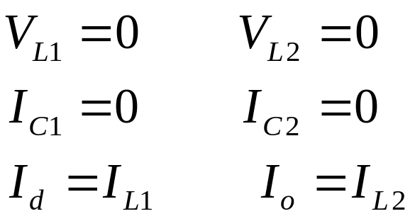
2 Steady-state analysis:
In the dc steady state:
i_{L1}
v_{C1}
i_{L2}
+
V_{d}
-
L₁
L₂
+ C₁ -
-
V_{o}
+
+ v_{L1} -
T
- v_{L2} +
D
R
C₂
i_{T}
i_{D}

Slide 6
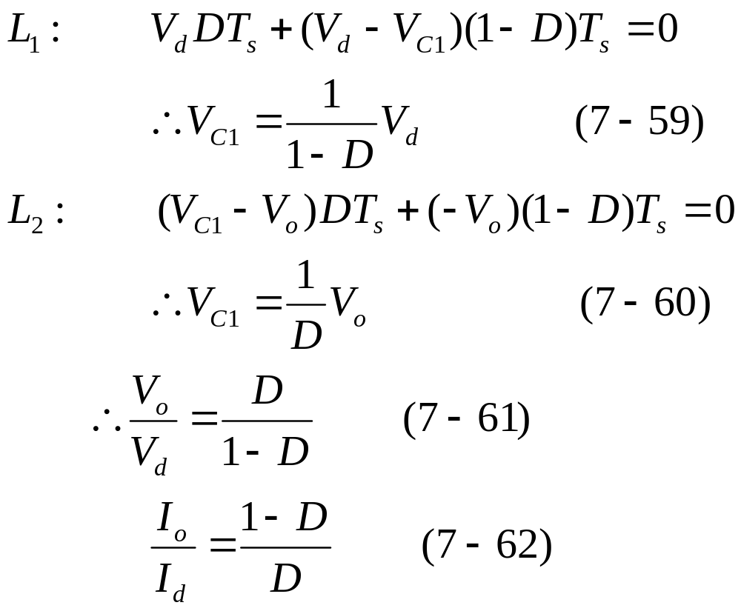
U
G
0
t
T
S
U
L1
U
d
0
t
T
−
(
U
c
1
−
U
d
)
i
S
L1
(
=
0
I
L
I
d
)
t
t
on
t
off
U
L2
U
c
1
−
U
0
o
t
−
U
o
T
S
i
L2
(
=
0
I
L
I
o
)
t
U
U
C1
T
V_{o} can be controlled by varying the duty ratio D.
0
t
i
T
0
t

Slide 7
Example 7-3
In a Cuk converter operating at 50kHz, L₁=L₂=1mH and C₁=5µF. The output capacitor is sufficiently large to yield an essentially constant output voltage. Here V_{d}=10V and the output V_{o} is regulated to be constant at 5V. It is supplying 5W to a load. Assume ideal components. Calculate the percentage errors in assuming a constant voltage across C₁ or in assuming constant current i_{L1} and i_{L2}.
Solution
(a) If the voltage across C₁ is assumed to be constant, from Eq. 7-58: v_{C1}=V_{C1}=V_{d}+V_{o}=10+5=15V.
Initially, we will assume the current conduction to be continuous. Therefore, from Eq. 7-61: D/(1-D)=5/10, D=0.33.

Slide 8
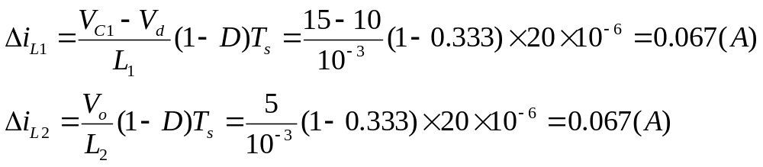
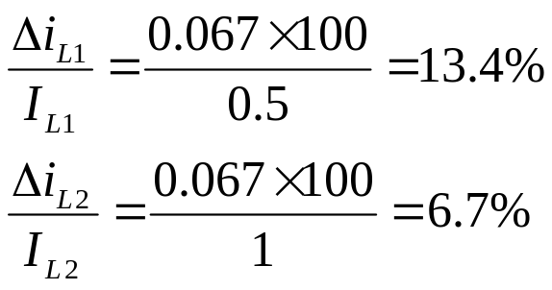
During the off interval:
At an output load of 5W: I_{o}=P_{o}/V_{o}=5/5=1A and I_{d}=0.5A.
Since Δi_{L1}<I_{d} (I_{L1}) and Δi_{L2}<I_{o} (I_{L2}), the mod of operation is continuous, as assumed earlier.
Therefore, the percentage errors in assuming constant I_{L1} and I_{L2} would be:
+
+
L
1
-
-
L
2
+
+
U
C1
U
-
-
U
L
U
L
C
R
U
d
1
2
o
+
-
D

Slide 9
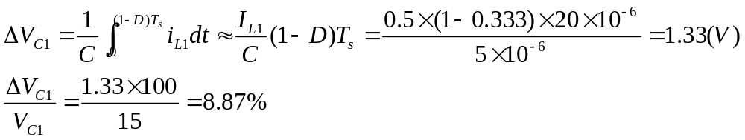
Solution
(b) If i_{L1} and i_{L2} are assumed to be constant, during the off interval:
+
+
L
1
-
-
L
2
+
+
U
C1
U
-
-
U
L
U
L
C
R
U
d
1
2
o
+
-
D

Slide 10
Chapter 27：Snubber Circuits
27-1 Induction
27-2 Diodes Snubber
27-3 Snubber Circuits for Thyristors
27-4 Need for Snubbers with Transistors
27-5 Turn-off Snubber
27-6 Overvoltage snubber
27-7 Turn-on Snubber

Slide 11
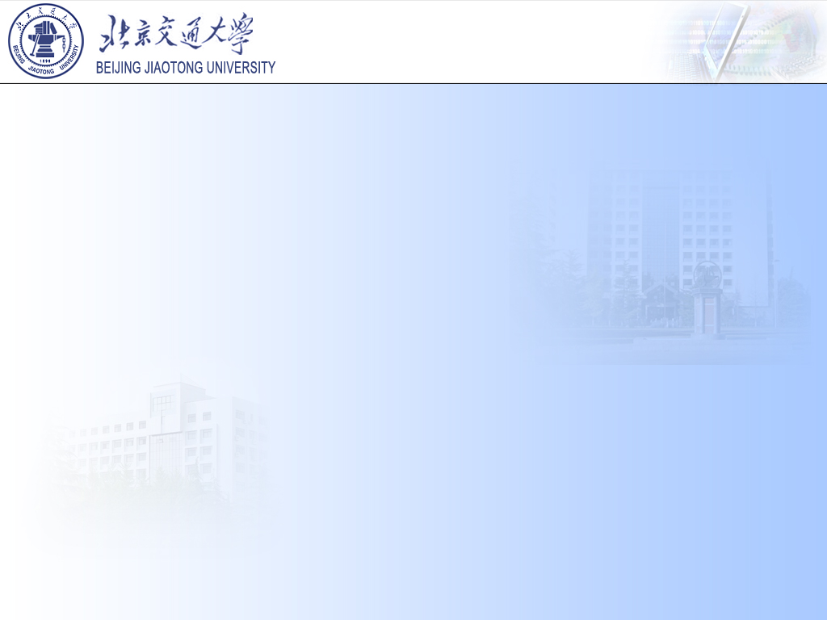
知识点：
1、掌握二极管与晶闸管、全控开关器件的缓冲电路的特性以及实现形式；
2、掌握开通缓冲电路、过压缓冲电路以及关断缓冲电路的特性以及实现形式。

Slide 12
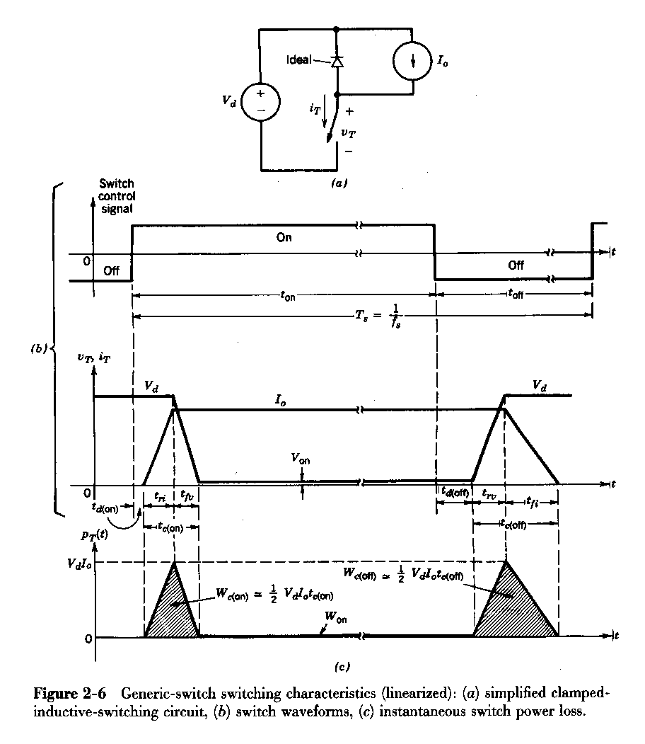
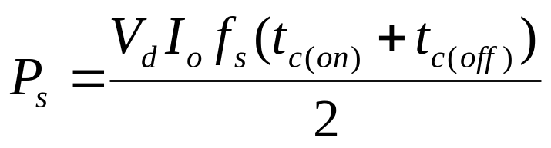

27-1 Induction
1 The issues which the switch faced in applications
(电力电子器件应用时面临的问题)
⑴ switching loss
→Switching loss f_{s}, we want f_{s}↑ So L, C size↓, but losses limit us.

Slide 13
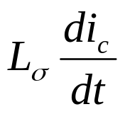
⑵ Overshoots (电压过冲)
L₁
L₂
I_{o}
V_{d}
i_{c}
+
v_{sw}
V_{d}
L₃
S_{w}
-
v_{SW}
L₁, L₂, L₃= stray inductance (杂散电感)
L_{σ}=L₁+L₂+L₃

Slide 14
⑶ Safe operating area (SOA)
Some devices have limitations on simultaneous voltage + current applied instantaneously (IGBT, MOSET, etc.)
i_{sw}
i_{L}
Turn-off locus
Device can operate at I_{L} and can operate at V_{in}, but not at same time
SOA
v_{sw}
V_{in}
v_{sw}
i_{sw}

Slide 15
⑷ di/dt or dv/dt limits
Also, some devices have di/dt or dv/dt limits (esp. thyristor type devices).
⑸ EMI
High di/dt, dv/dt lead to EMI, affects control circuits. (dv/dt→ capacitive coupling, di/dt→ inductive coupling)

Slide 16
2 The ways which the switch being overstressed in applications (电力电子器件承受的过度冲击的方式/类型)
Five possibilities for overstresses：
at turn-off
① Overvoltage and ② high dv/dt
at turn-on
③ Overcurrent and ④ high di/dt,
other
⑤ Excessive power dissipation.

Slide 17
Snubber circuit can be added to the basic converter to reduce the stresses to safe levels.
i
L_{s}
The di/dt is limited by adding a series inductor L_{s}
C_{s}
The dv/dt is limited by connecting a capacitor C_{s}

Slide 18
3 Snubber’s Function ☆ : Protect semiconductor devices by:
Shaping the switching trajectory of the device as it turns on/off and lows the device dissipation.
(改变器件开通/关断轨迹来降低器件的开关损耗)
Limiting device voltages during turn-off transients
Limiting the rate-of-rise (dv/dt) of voltages across the semiconductor device at device turn-off.
(限制器件关断期间承受的电压和承受的dv/dt)

Slide 19
3 Snubber’s Function ☆ : Protect semiconductor devices by:
Limiting device currents during turn-on transients
Limiting the rate-of-rise (di/dt) of currents through the semiconductor device at device turn-on
(限制器件开通期间承受的电流和承受的di/dt)

Slide 20
4 Types of Snubber Circuits ☆
(1) Unpolarized R-C snubbers (无极性RC缓冲电路)
Used to protect diodes and thyristors by limiting the maximum voltage and dv/dt at reverse recovery
P
+
L
σ
L_{σ}
1
3
5
R_{s}
v_{an}
I_{o}
-
+
L_{σ}
A
V_{d}
-
v_{bn}
+
D_{f}
C_{s}
B
i_{d}
v_{cn}
L_{σ}
-
+
-
C
S_{w}
snubber
C_{s}
4
6
2
R_{s}

Slide 21
(2) Polarized R-C snubbers (有极性RC缓冲电路)
• Used as turn-off snubbers to shape the turn-off switching trajectory of controlled switches.
• Used as overvoltage snubbers to clamp voltages applied to controlled switches to safe values.
• Limit dv/dt during device turn-off
turn-off snubbers
(关断Snubber)
Overvoltage Snubber
(过电压Snubber)
L
σ
Turn-off snubber
i_{Df}
D_{f}
I_{o}
+
+
D_{f}
I_{o}
R_{ov}
V_{d}
D_{s}
V_{d}
S_{w}
R_{s}
S_{w}
D_{ov}
-
i_{Cs}
C_{s}
-
C_{ov}

Slide 22
(3) Polarized L-R snubbers (有极性LR缓冲电路)
• Used as turn-on snubbers to shape the turn-on switching trajectory of controlled switches.
• Limit di/dt during device turn-on
+
+
D_{f}
I_{o}
R_{Ls}
I_{o}
Snubber circuit
L_{s}
D_{Ls}
R_{Ls}
V_{d}
L_{s}
V_{d}
D_{Ls}
D_{f}
-
S_{w}
-
S_{w}

Slide 23
27-2 Diode Snubber Circuit
1 Switching Waveforms
A power diode requires a finite time to switch from blocking state to the on state (forward bias) and vice versa.
Forward-recovery voltage(正向恢复峰值电压) V_{FP}
Q_{rr}=I_{rr}t_{rr}/2
di_{F}/dt
di_{R}/dt
0.25I_{rr}
I_{F}
t
The overshoot of the voltage during turn-on is not observed.
I
r
r
t₃
t₄
t₅
V_{FP}
V_{on}
t_{rr}
Forward-recovery time(正向恢复时间) (t_{fr}=t₁+t₂)
t
t₂
V_{rr}
V_{R}
t₁
t
5
S
=
t
4

Slide 24
27-2 Diode Snubber Circuit
Reverse-recovery voltage(反向恢复峰值电压) V_{rr}
Q_{rr}=I_{rr}t_{rr}/2
di_{F}/dt
di_{R}/dt
0.25I_{rr}
I_{F}
t
I
r
r
Reverse-recovery current(反向恢复峰值电流) I_{rr}
t₃
t₄
t₅
V_{FP}
V_{on}
t_{rr}
Reverse-recovery time(反向恢复时间) t_{rr}
t
t₂
V_{rr}
V_{R}
t₁
t
5
S
=
t
4

Slide 25
27-2 Diode Snubber Circuit
Q_{rr}=I_{rr}t_{rr}/2
Reverse-recovery charge (反向恢复电荷) Q_{rr}=I_{rr}t_{rr}/2
di_{R}/dt
di_{F}/dt
I_{F}
0.25I_{rr}
t
I
r
r
“snappiness” factor (恢复系数) S=t₅/t₄
t₃
t₄
t₅
V_{FP}
V_{on}
t_{rr}
t
t₂
V_{rr}
V_{R}
t₁
t
5
S
=
t
4
Soft-recovery diode (软恢复二极管): t₅>>t₄
Abrupt-recovery diode (硬恢复二极管): t₅<<t₄

Slide 26
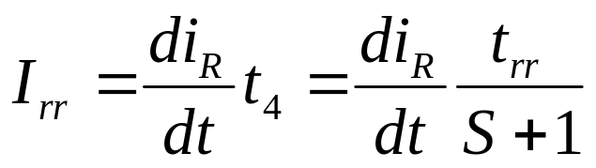
27-2 Diode Snubber Circuit
di_{F}/dt and di_{R}/dt are determined by external circuit.
Q_{rr}=I_{rr}t_{rr}/2
di_{F}/dt
di_{R}/dt
0.25I_{rr}
I_{F}
t
I
r
r
t₃
t₄
t₅
V_{FP}
V_{on}
t_{rr}
t
t₂
V_{rr}
V_{R}
t₁
t
5
S
=
t
4

Slide 27
27-2 Diode Snubber Circuit
2 The cause of overvoltages
The overvoltages occur due to the stray(杂散电感) or leakage inductance L_{σ} in series with the diode and the snap-off of the diode reverse recovery current.
di_{Df}
V_{d}
=
+
L
σ
I
dt
L
σ
o
t
I_{o}
i_{Df}(t)
-
v_{D}
+
I_{rr}
V_{d}
D_{f}
-
v_{Df}(t)
t
S_{w}
V_{d}
Diode voltage without snubber
di_{L}
L
σ
L_{σ} =stray inductance
σ
dt

Slide 28
27-2 Diode Snubber Circuit
3 overvoltage protection
Introducing a R_{s}-C_{s} snubber circuit
+
L
σ
R_{s}
The roles of elements
C_{s}的作用是限制D_{f}上的dv/dt和关断过电压；
R_{s}的作用是限制C_{s}的放电电流。
I_{o}
V_{d}
D_{f}
C_{s}
-
S_{w}
snubber

Slide 29
27-3 Snubber Circuit for Thyristors
The cause of overvoltages
The overvoltages occur due to the series inductance L_{σ} (line reactance +transformer leakage inductance) and the snap-off of the thyristor reverse recovery current.
P
I_{d}
5
t
v_{an}
L_{σ}
1
3
I_{rr}
-
+
L_{σ}
A
-
v_{bn}
+
L_{σ}
B
i_{d}
t
-
v_{cn}
+
C
C_{s}
Thyristor voltage without snubber
4
6
2
R_{s}

Slide 30
27-4 Need for Snubbers with Controlled Switches
Snubber circuits are used to protect the transistors by improving their switching trajectory. Three basic types of snubbers:
1 Turn-off snubbers
2 Turn-on snubbers
3 Overvoltage snubbers
Step-down converter example
L₁
L₂
I_{o}
V_{d}
i_{c}
+
L₁, L₂, L₃= stray inductance
L_{σ}=L₁+L₂+L₃
v_{sw}
L₃
S_{w}
-
Fig. 27-11(a)

Slide 31
Switch current and voltage waveforms
I_{rr}
L₁
L₂
i_{SW}
I_{o}
V_{d}
I₀
V_{d}
I₀
i_{c}
+
L₃
S_{w}
v_{sw}
v_{SW}
-
t₀
t₁
t₃
t₄
t₅
t₆
Fig. 27-11(a)
Fig. 27-11(c)
Turn-off: at t=t₀, the switch voltage begins to rise,
at t=t₁, the diode begins to conduct,
at t=t₃, the voltage comes down to V_{d},
Turn-on: at t=t₄, the switch current begins to rise,
at t=t₅, the freewheeling diode recovers,
at t=t₆, the switch voltage decreases to zero.

Slide 32
idealized switching loci
i_{sw}
t₆
t₅
I_{rr}
i_{SW}
t₀
turn-off
t₁
I₀
V_{d}
I₀
turn-on
v_{SW}
t₄
t₃
t₀
t₁
t₃
t₄
t₅
t₆
v_{sw}
V
d
Fig. 27-11(c)
Fig. 27-11 (b)
Both voltage and current of the switch are high simultaneously at turn-on and turn-off, thus causing a high instantaneous power dissipation.
The stray inductances result in overvoltage beyond V_{d}.
The diode reverse-recovery current causes overcurrent beyond I_{o}.

Slide 33
27-5 Turn-off Snubber for Controlled Switches☆
Step-down converter with turn-off snubber
1 The goal of a turn-off snubber is to provide a zero (low) voltage across the switch while the current turns off.
Turn-off snubber
i_{Df}
D_{f}
I_{o}
+
V_{d}
D_{s}
S_{w}
R_{s}
-
i_{Cs}
C_{s}
2 RCD snubber 工作原理
D_{s} shorts out R_{s} during S_{w} turn-off.
During S_{w} turn-on, D_{s} reverse-biased and C_{s} discharges through R_{s}.
Fig. 27-12 (a)

Slide 34
3 RCD snubber 各元件的作用
C_{s}的作用是限制上S_{w}的dv/dt和限制关断过电压；
R_{s}的作用是当S_{w}开通时泄放C_{s}上的能量，并限制放电电流；
D_{s}的作用是当S_{w}关断时使R_{s}短路，更好发挥限制上S_{w}的dv/dt和限制关断过电压的作用。
Turn-off snubber
i_{Df}
D_{f}
I_{o}
+
V_{d}
D_{s}
S_{w}
R_{s}
-
i_{Cs}
C_{s}

Slide 35
4 RCD snubber 电路分析
⑴ Equivalent circuit during switch turn-off.
Turn-off snubber
i_{Df}
D_{f}
I_{o}
I_{o}
+
D_{f}
V_{d}
D_{s}
V_{d}
I_{o}-i_{sw}
S_{w}
R_{s}
i_{sw}
-
i_{Cs}
C_{s}
C_{s}
Fig. 27-12 (a)
Fig. 27-12 (b)

Slide 36
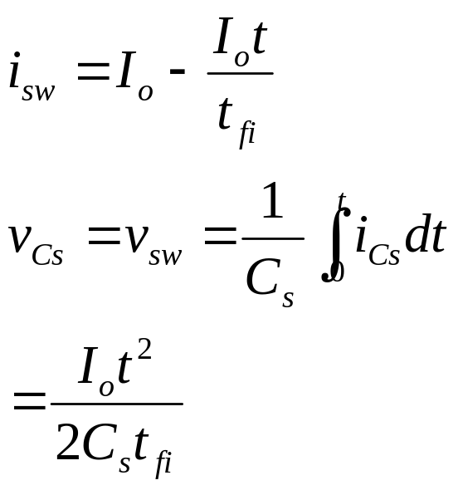
⑵ Circuit waveforms for various values of C_{s}
i_{sw}
i_{sw}
i_{sw}
I_{o}
i_{Df}
i_{Df}
i_{Df}
t_{fi}
t_{fi}
t_{fi}
i_{Cs}
V_{d}
V_{d}
V_{d}
v_{Cs}
C_{s}<C_{s1}
C_{s}=C_{s1}
C_{s}>C_{s1}
Fig. 27-12 (c)
Simplifying assumptions
(1) No stray inductance
(2) i_{SW}(t) uneffected by snubber circuit and changed linearly.

Slide 37
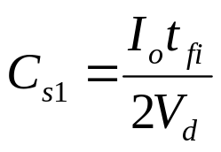
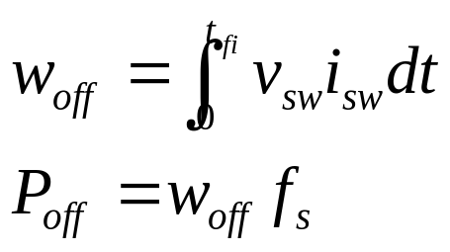
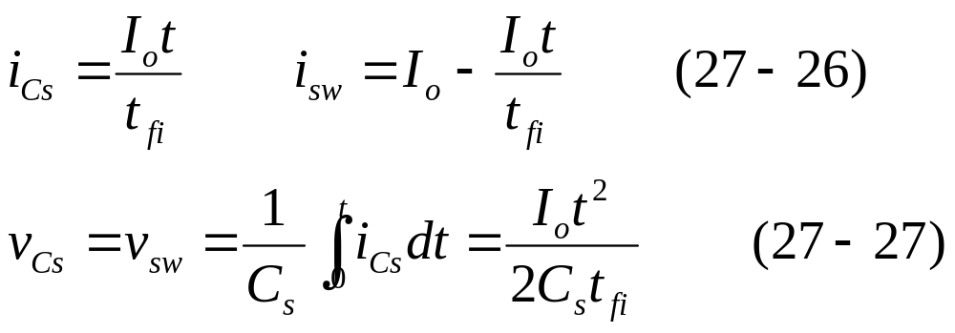
i_{sw}
i_{sw}
i_{sw}
I_{o}
For a current fall time t_{fi}, when 0<t<t_{fi}
i_{Df}
i_{Df}
i_{Df}
t_{fi}
t_{fi}
t_{fi}
i_{Cs}
V_{d}
V_{d}
V_{d}
v_{Cs}
C_{s}<C_{s1}
C_{s}=C_{s1}
C_{s}>C_{s1}

Slide 38
Turn-off Snubber for Controlled Switches
5 The turn-off Switching trajectory(关断轨迹)
i_{sw}
i_{sw}
I_{o}
RBSOA
C_{s}<C_{s1}
turn-off
C_{s}=C_{s1}
C_{s}>C_{s1}
v_{sw}
V
V_{d}
v_{sw}
d
Fig. 27-13 Switching trajectory during turn-off with various values of snubber capacitance C_{s}.

Slide 39
27-6 Overvoltage Snubber
Step-down converter with overvoltage snubber comprised of D_{ov}, C_{ov}, and R_{ov}.
Overvoltage snubber limits overvoltage (due to stray Inductance) across S_{w} as it turns off.
L
σ
+
D_{f}
I_{o}
R_{ov}
V_{d}
S_{w}
D_{ov}
-
C_{ov}
Fig. 27-16(a) Overvoltage snubber

Slide 40
The roles of elements
C_{ov}的作用是限制S_{w}上的dv/dt和限制关断过电压；
R_{ov}的作用泄放C_{ov}上的能量，并限制放电电流；
D_{ov}的作用是提供C_{ov}充电回路，更好发挥限制S_{w}的dv/dt和限制关断过电压的作用。
L
σ
+
D_{f}
I_{o}
R_{ov}
V_{d}
S_{w}
D_{ov}
-
C_{ov}

Slide 41
Turn-on Snubber
27-7 Turn-on Snubber
1 Step-down converter with turn-on snubber
+
+
D_{f}
I_{o}
R_{Ls}
I_{o}
Snubber circuit
L_{s}
D_{Ls}
R_{Ls}
V_{d}
L_{s}
V_{d}
D_{Ls}
D_{f}
-
S_{w}
-
S_{w}
Fig. 27-17 (a) and (b)

Slide 42
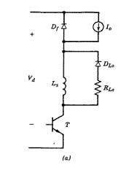
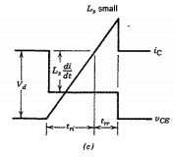

Slide 43
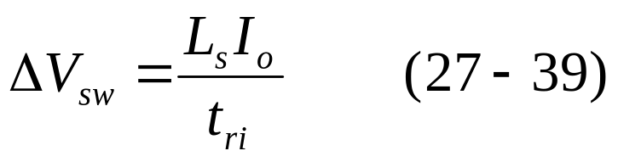
Turn-on Snubber
2 Switching trajectory with and without turn-on snubber.
i_{sw}
I_{o}
With
Without
snubber
snubber
di_{sw}
L
s
dt
v_{sw}
V_{d}
The reduction in the voltage across the switch during turn-on is:

Slide 44
Summary
1. Snubber circuits protect semiconductor devices during turn-on and turn-off transients by limiting voltage and current magnitudes and rates of rise and by shaping the switching trajectory of the device as it turns on and off.
2. There are three topological snubber configurations: unpolarized RC snubbers, polarized RC snubbers, and polarized RL snubbers.
3. Unpolarized RC snubbers protect diodes and thyristors from overvoltages generated by the reverse-recovery current snap-off in the presence of stray series inductance.

Slide 45
Summary
4. A polarized RC circuit functions as turn-off Snubber to protect all types of controlled switches (IGBT, MOSFET, etc) by providing a low voltage across the switch while the current turns off. The turn-off switching trajectory traverses a low-power dissipation portion of the output I-V plane and the rate of rise (dv/dt) of the voltage across the device during turn-off is controlled.
5. A polarized RC circuit with a different topology than a turn-off snubber can be used as an overvoltage snubber to limit the overvoltage experienced by a controlled switch when it turns off in the presence of series inductance.

Slide 46
Summary
6. A polarized RL snubber protects controlled switches by reducing the voltage across a device as the current through it builds up during the turn-on transient. These turn-on snubbers can also be designed to limit overcurrents in the device during the turn-on transient due to diode reverse recovery.

Slide 47
Review Questions
What are the Snubber’s Functions?
What is a polarized snubber?
What is a nonpolarized snubber?
What is the cause of reverse recovery transient voltages?
5. What is the purpose of di/dt protection?
6. What is the common method of di/dt protection?
7. What is the purpose of dv/dt protection?
8. What is the common method of dv/dt protection?
9. What is the turn-off characteristic of thyristors?

